Slide 1
Writing Professional and Effective Emails

Slide 2
Prefatory elements
1) To
Recipient’s email
2) Cc (Carbon copy / courtesy copy)
If you would like to send a copy of an e-mail to individuals other than your primary correspondent, you should type their e-mail addresses in the Cc (“carbon copy / courtesy copy”) field.

Slide 3
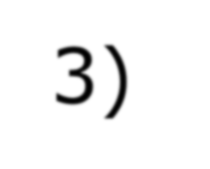

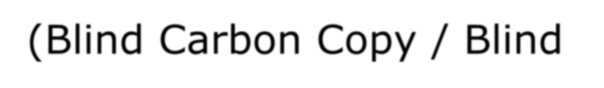
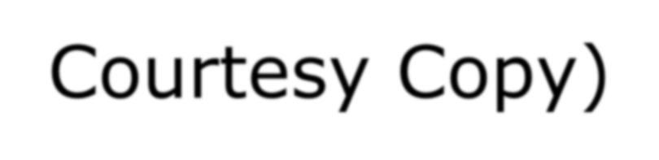
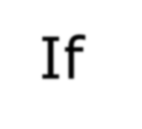
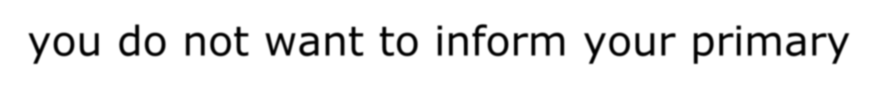




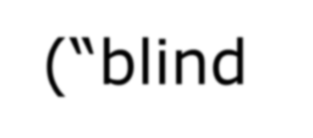
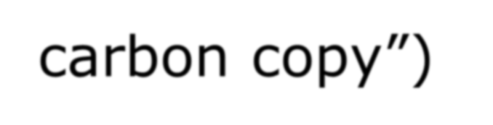
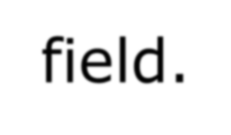
3) Bcc (Blind Carbon Copy / Blind Courtesy Copy)
If you do not want to inform your primary correspondent that you sent a copy of the e-mail, then type the additional recipients’ names in the Bcc (“blind carbon copy”) field.

Slide 4
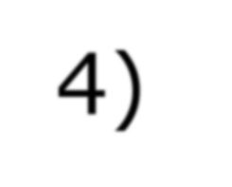



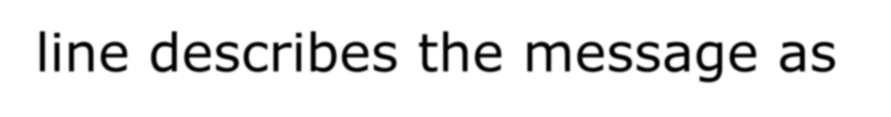

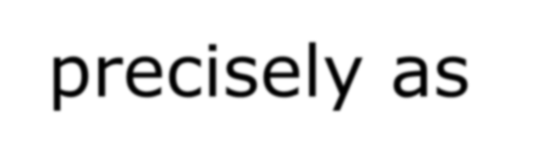
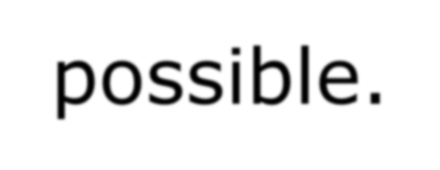
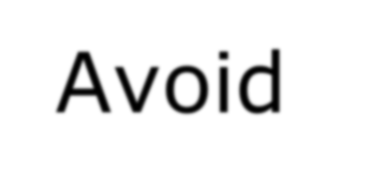
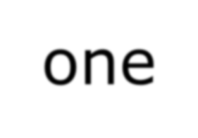


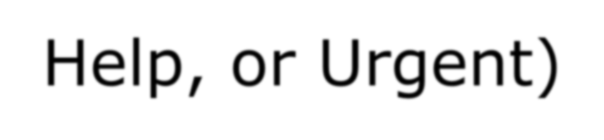
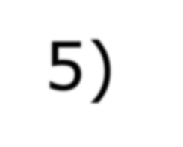

4) Subject:
This line describes the message as precisely as possible.
Avoid one-word descriptions (e.g., Important, Help, or Urgent)
5) Attachments:
Attach a file that is needed with the email.

Slide 5
EMAIL - Subject
The subject should be focused, clear and informative.

Slide 6
Ineffective subject lines
SUBJECT
Hi Teacher
Question
We are confuse
Can I write more in the slide
The assignment
(sometimes, students write the whole content at the subject)

Slide 7
Effective subject lines
SUBJECT
Questions on MPU2.2 – Number of slides
Group members issues for ASG 1 (WPP)
Some questions on Ethos
Writing for Professional Purposes Assignment 1 Matters
Assignment 2 Grouping issues for MPU2.2

Slide 8
Greetings
Dear [name],
To whom it may concern,

Slide 9
Content
Evaluate the situation
Choose the relevant approach; direct or indirect
Paragraph: minimum 2, maximum 5

Slide 10
Sign-offs
For email writing, the sign-off is not restricted to only 2 options:
Yours faithfully, (for general greeting)
Yours sincerely, (for specific greeting)
Best Regards, (for specific greeting)
Regards, (for specific greeting)
Best wishes, and etc. (for specific greeting)

Slide 11
Signature (optional)
Name (mandatory)
Title/Position (based on situation)
Company name (additional)
Phone/Fax (additional)

Slide 12
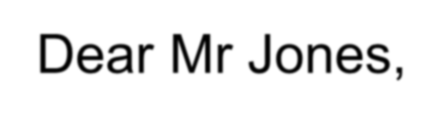
Example of Good Email
To: nurhidayatulakma.safian@xmu.edu.my
Subject: Inquiry about IELTS classes
Dear Ms. Akma,
I’m Yang, a student from China. I’m writing to enquire about the IELTS classes. I have a few questions:
How many hours a week are the courses?
What sort of speaking sessions do you offer?
Which session should I register for if I want to take the IELTS exam?
I’m hoping to register for my IELTS soon, so if you can get back to me latest by end of this month, it would be great. Thanks for your help.
Best regards,

Slide 13
Format
DON’T type in ALL CAPS:
It’s unprofessional (unless it’s urgent) and can indicate rudeness in writing.

Slide 14
Happy emailing!

